Slide 1

Programming
Lecture 10
Windows Form Part 1

Slide 2
Agenda
GUI & Visual Programming
Overview
Installation
Form and Control
Label
Text
Button
PictureBox
Event

Slide 3
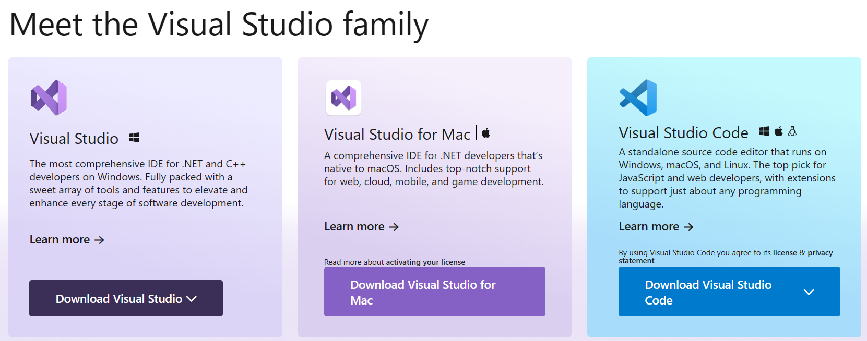
GUI & Visual Programming
Website: Visual Studio: IDE and Code Editor for Software Developers and Teams (microsoft.com)

Slide 4
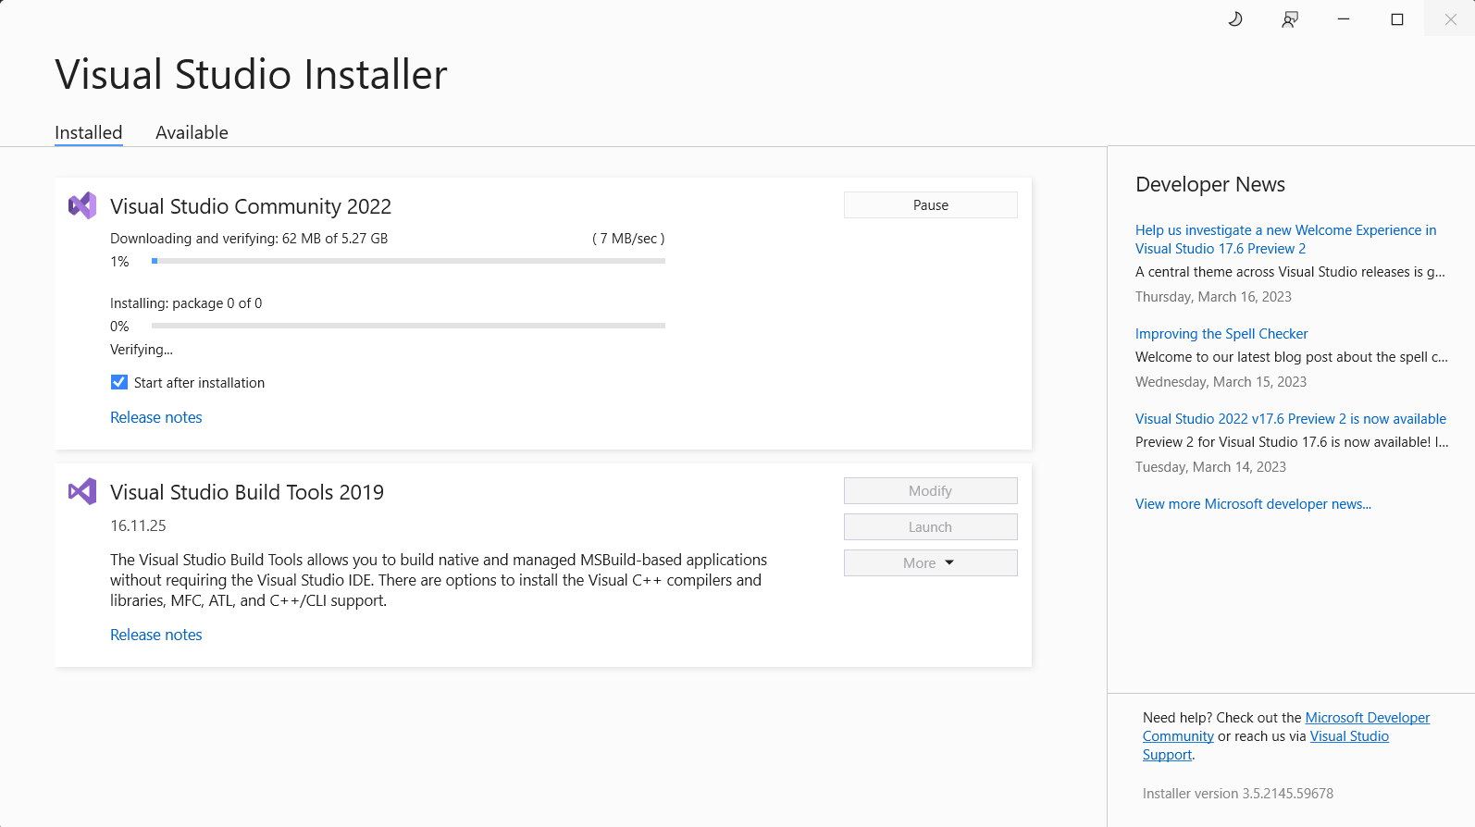
GUI & Visual Programming

Slide 5
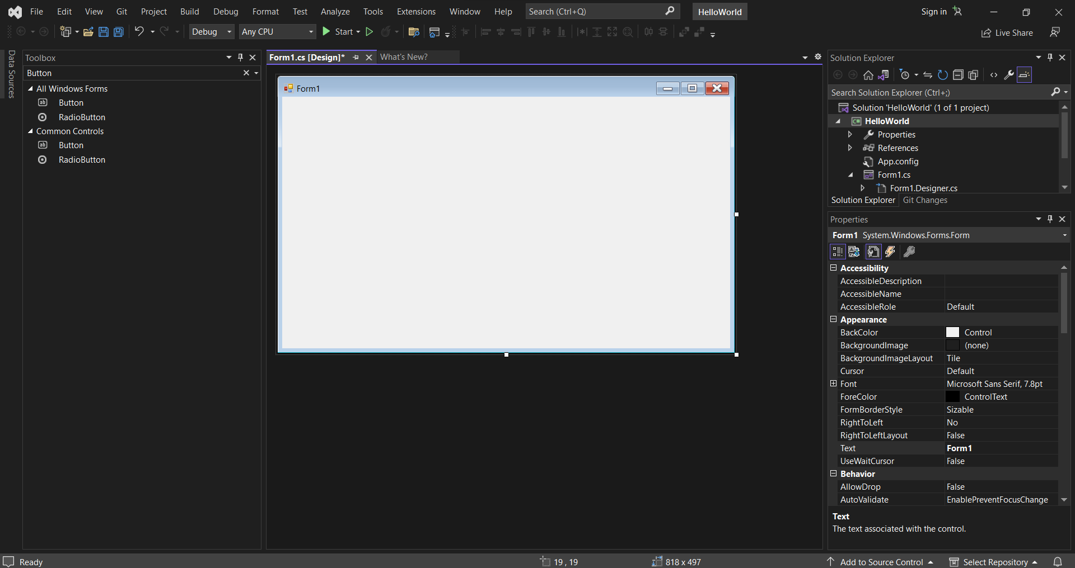
GUI & Visual Programming

Slide 6
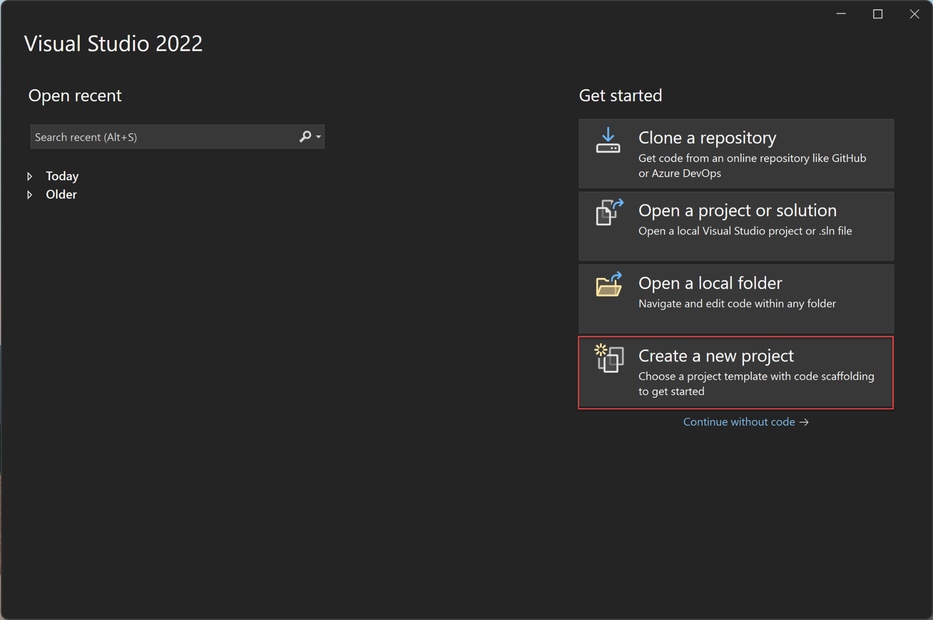
Create new Project
Open Visual Studio.On the start window, select Create a new project.

Slide 7
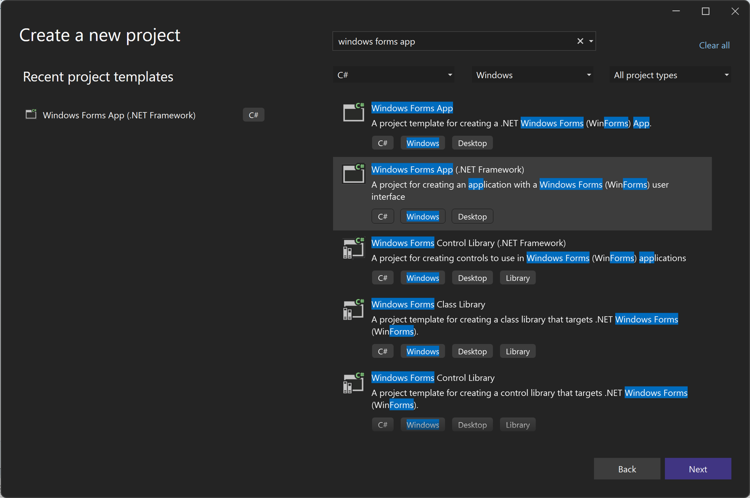
Create new Project
On the Create a new project window, select the Windows Forms App (.NET Framework) template for C#.

Slide 8
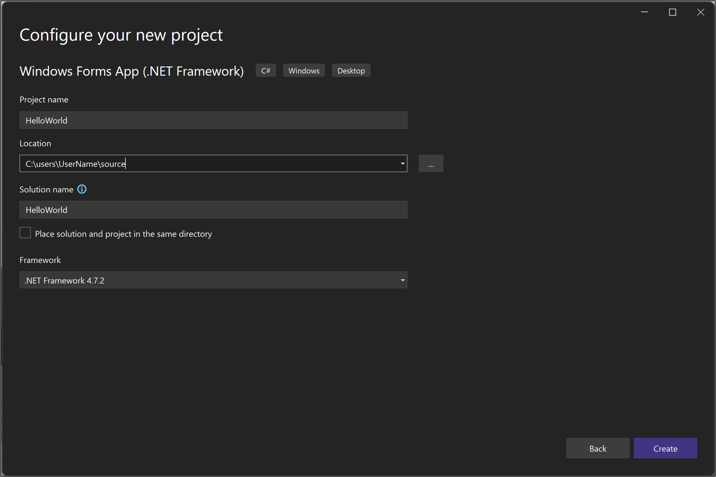
Create new Project
In the Configure your new project window, type or enter HelloWorld in the Project name box. Then, select Create.
Project name
Select location
Enter solution name
Select framework

Slide 9
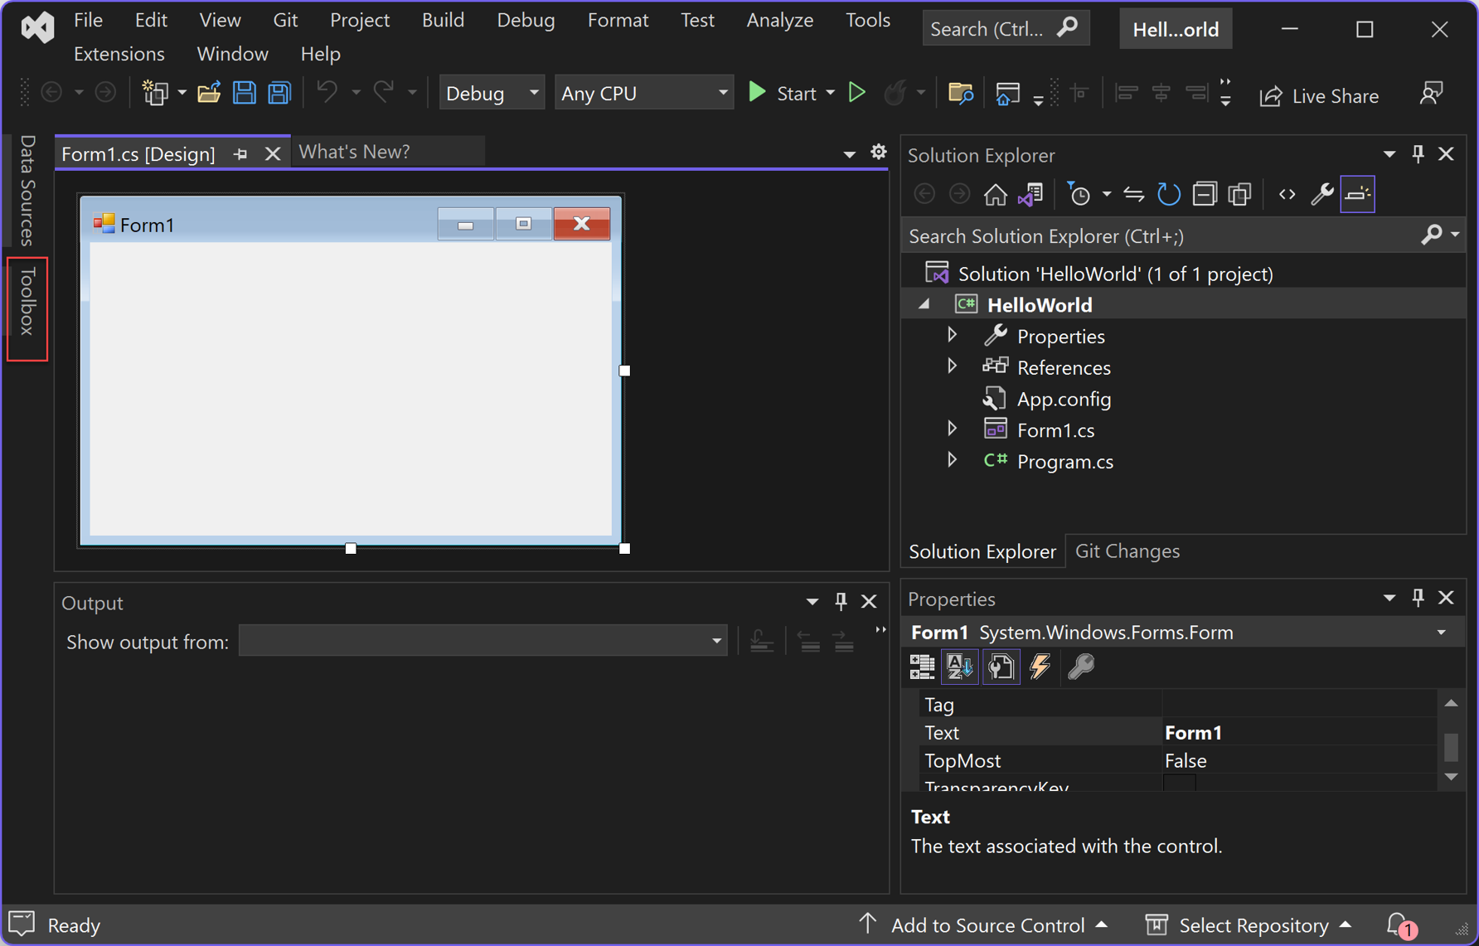
Create the application
Add a button to the form
Select Toolbox to open the Toolbox fly-out window.

Slide 10
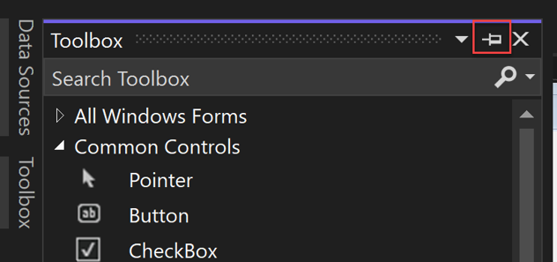
Toolbox
Expand Common Controls and select the Pin icon to dock the Toolbox window.

Slide 11
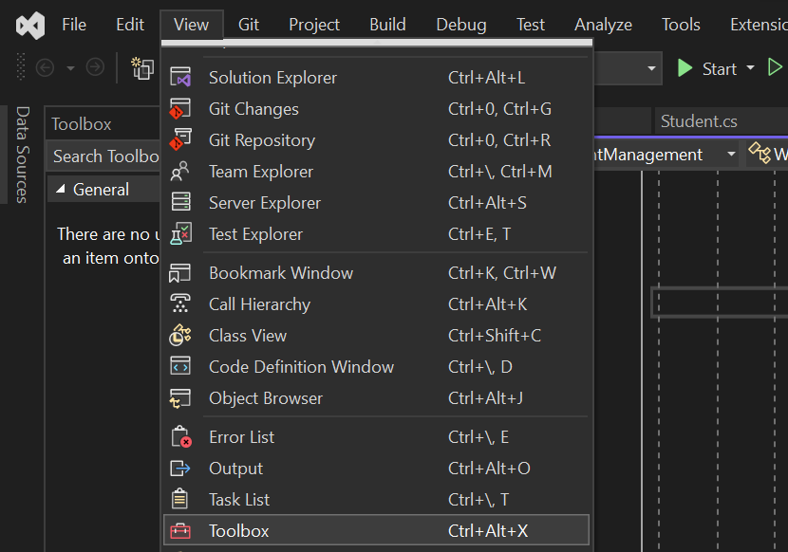
Toolbox
If Toolbox invisible, go to View menu -> Toolbox

Slide 12
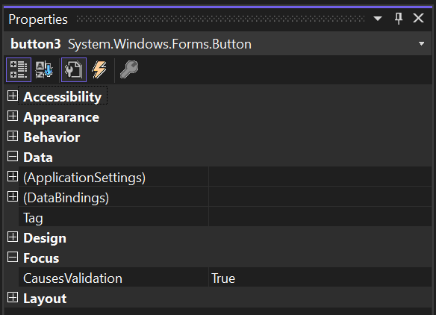
Properties
In Right Panel, It show properties of components in Form like Accessibility, Appearance, Behavior, Data, Design,...

Slide 13
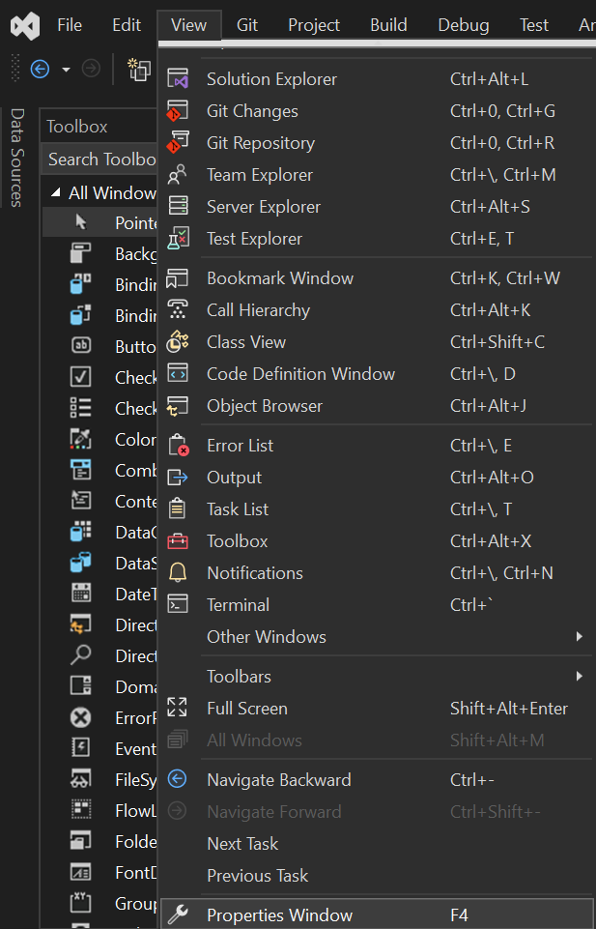
Properties
If Properties panel invisible, choice View menu -> Properties Window

Slide 14
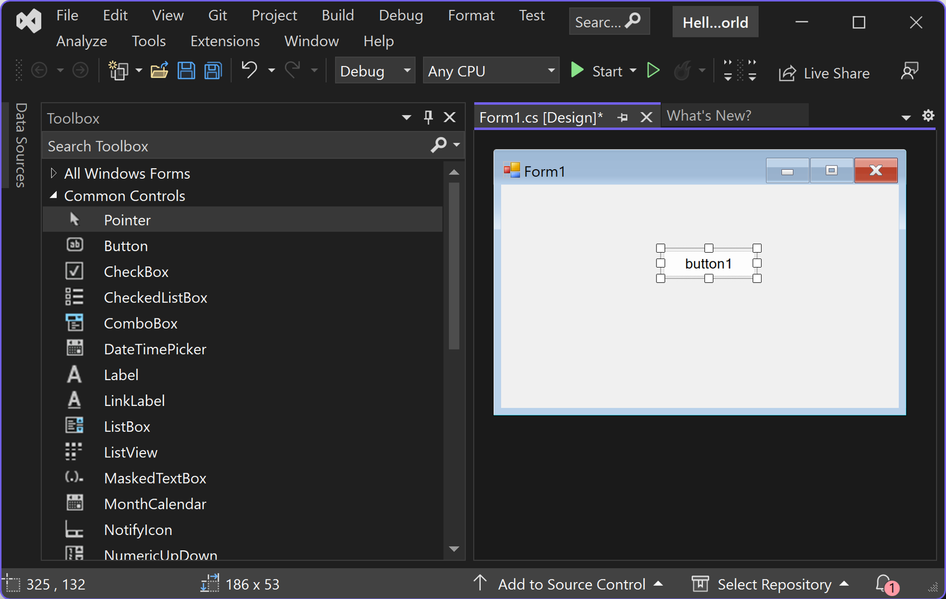
Button
Add a button to the form
Select the Button control and then drag it onto the form.

Slide 15
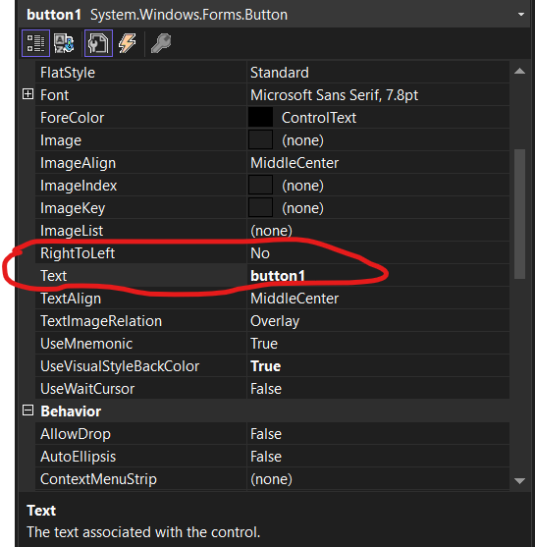
Button
Add a button to the form
Change Text Button display on Form - In Font choice Text and Rename

Slide 16
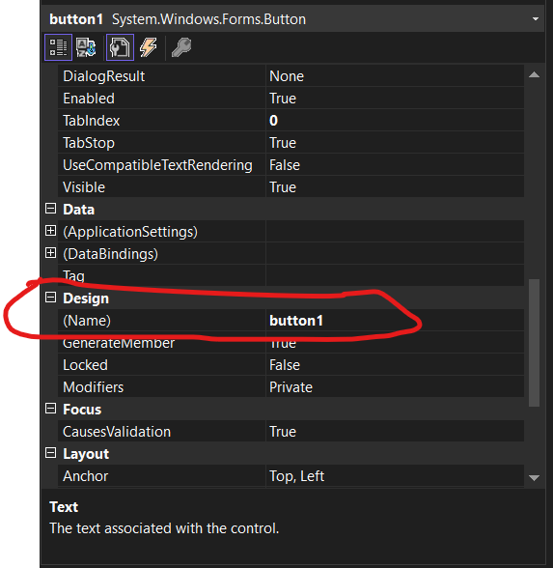
Button
Set variable name
Set Variable Name for Button In Design choice Name and rename like next figure

Slide 17
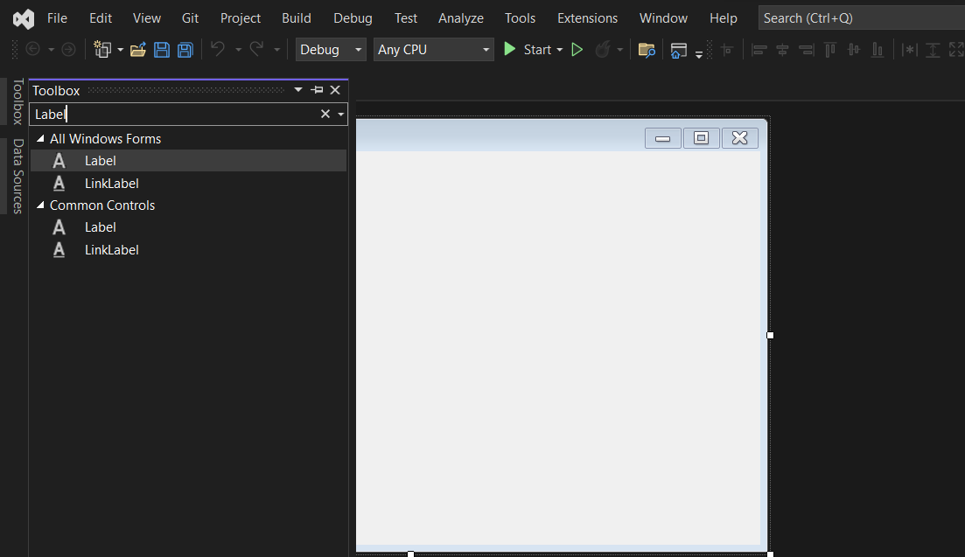
Label
Add label from Toolbox
Select the Label control from the Toolbox window, and then drag it onto the form and drop it beneath the Click this button.

Slide 18
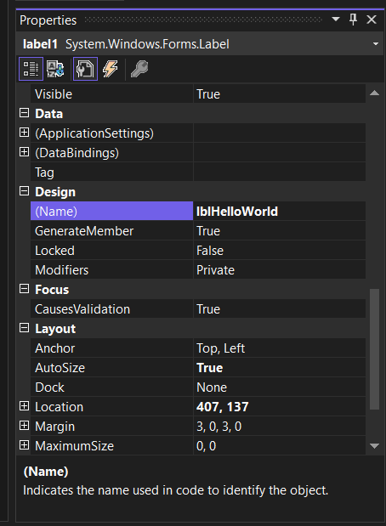
Label
Change label variable name
In Toolbox choice Design -> change label variable name

Slide 19
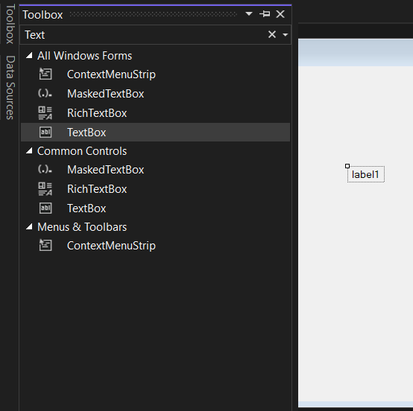
TextBox
Add a TextBox to the form
Select the TextBox control from the Toolbox window, and then drag it onto the form and drop it beneath the Click this button

Slide 20
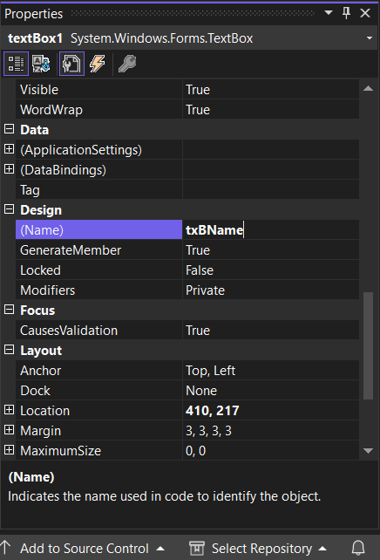
TextBox
Add a TextBox to the form
In either the Design section or the (DataBindings) section of the Properties window, change the name of label1 to txBName, and then press Enter.

Slide 21
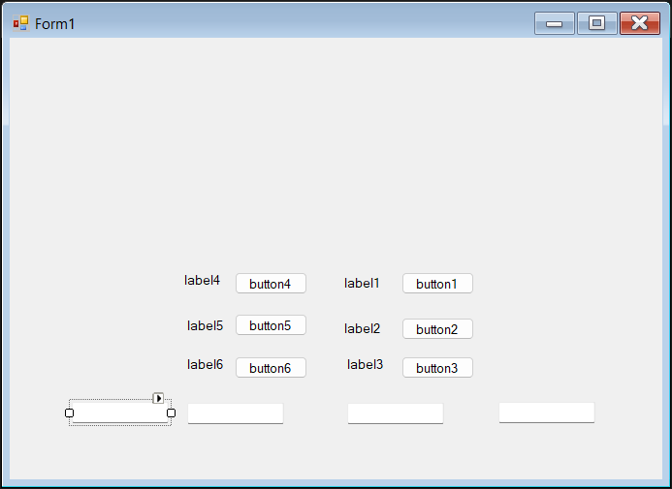
TextBox
Add a TextBox to the form

Slide 22
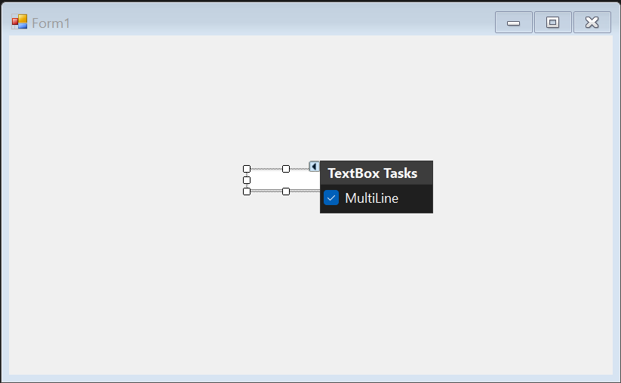
TextBox
Resize TextBox - Option 1
Select TextBox and Click on Top -> Check Multiline

Slide 23
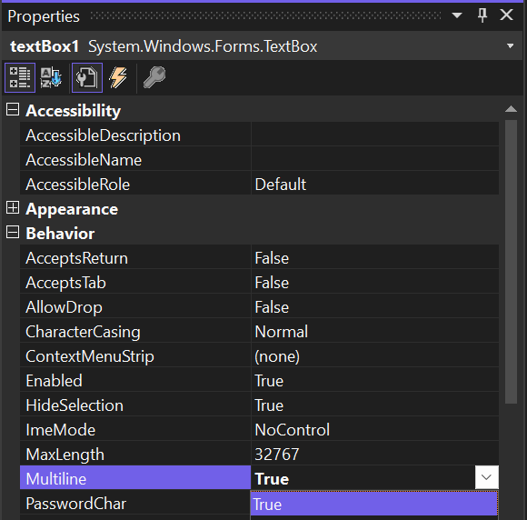
TextBox
Resize TextBox - Option 2
In Properties panel choice Behavior -> Multiline -> Select True

Slide 24
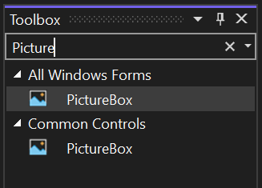
Image- PictureBox
Add PictureBox
In Toolbox choice PictureBox and drag to Form in Design - PictureBox can load and display a picture on a form at design time by setting the Image property to a valid picture

Slide 25
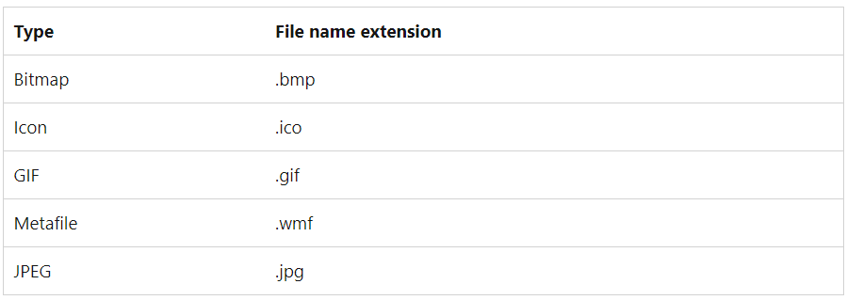
Image- PictureBox
Format support

Slide 26
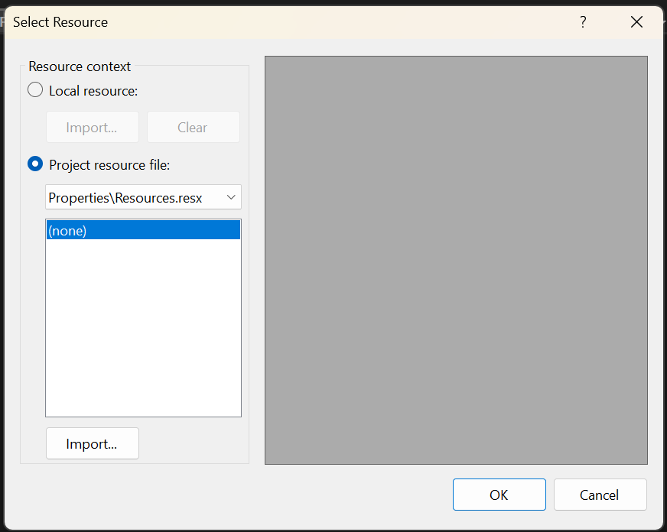
Image- PictureBox
Load new image
In properties panel -> Appearance ->Background Image to load image from your computer.
Choice Local resource and click Import button -> Select image file

Slide 27
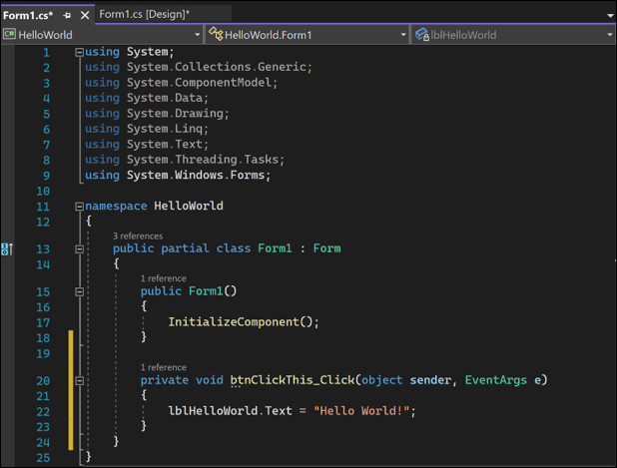
Event
In the Form1.cs [Design] window, double-click the Click this button to open the Form1.cs window.
In the Form1.cs window, after the private void line, type or enter lblHelloWorld.Text = "Hello World!"

Slide 28
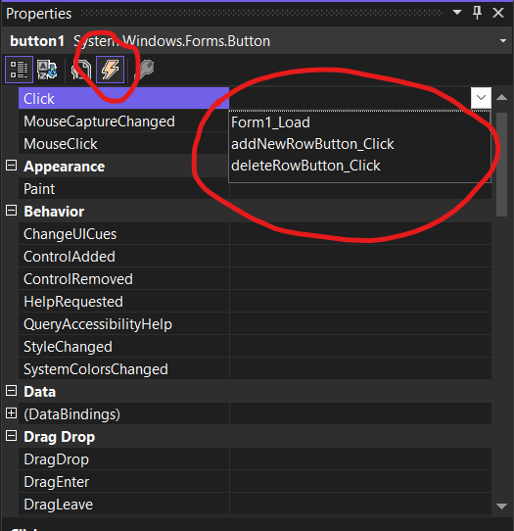
Event
Choice Event and Select function define in source

Slide 29
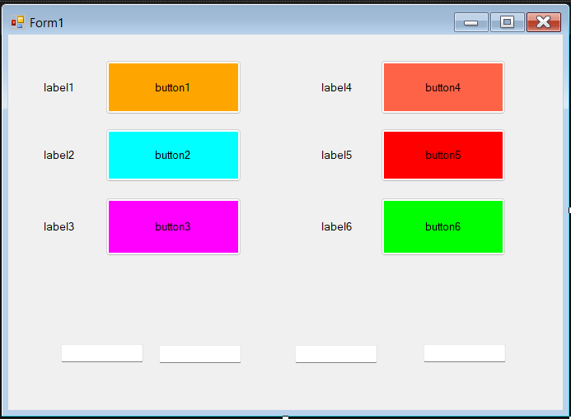
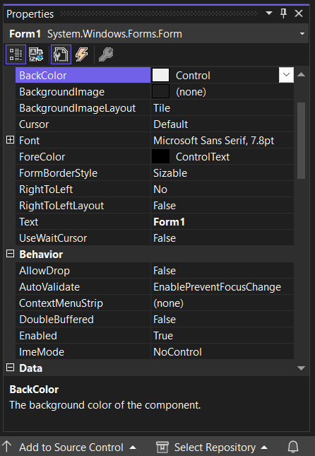
Tips
Change background color Button, Form,.. by set BackColor in Properties Panel

Slide 30
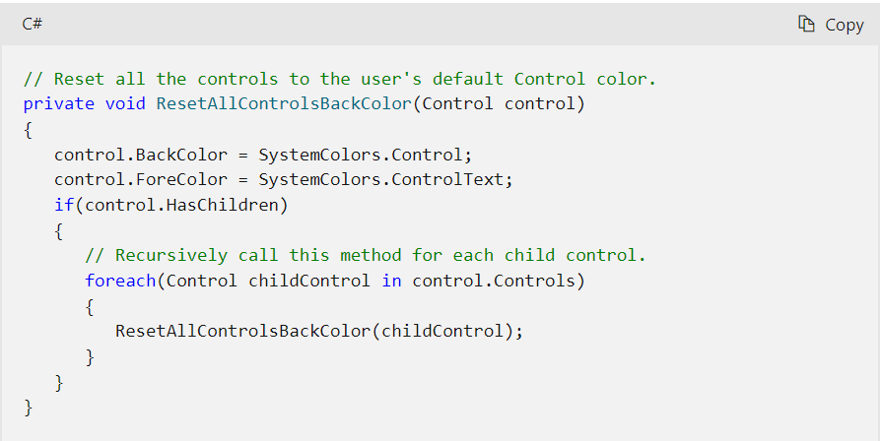
Tips
Change background color Button

Slide 31
Practises
Change Color Button by set BackColor in source
Drag 2 Button to Form and set Event to change BackColor of Form
Design Login Form

Slide 32
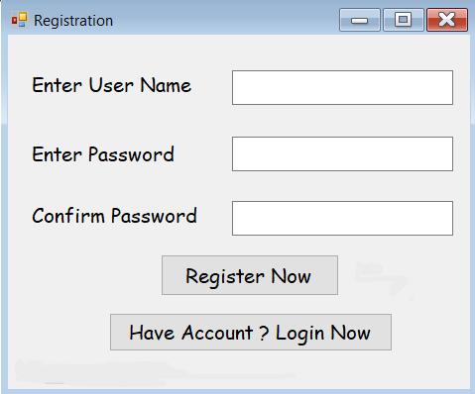
Practises
Registration Form demo

Slide 33
Thank you!
Notes:
33

